Slide 1

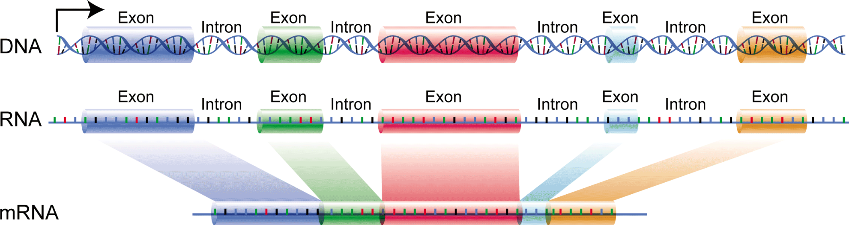

Anatomy of a Gene
5’ Untranslated
region (5’UTR)
3’ Untranslated
region (3’UTR)
Promoter (on/off)
enhancer
response element
TATA Box
(poly)A signal
Gene protein coding sequences are not sequential in the chromosome. They are broken up and have to be spliced together at the time the mRNA is transcribed (made). An exon is that part of a gene that codes for a protein and are spliced together, while the introns are the intervening sequences that are chopped out.

Slide 2
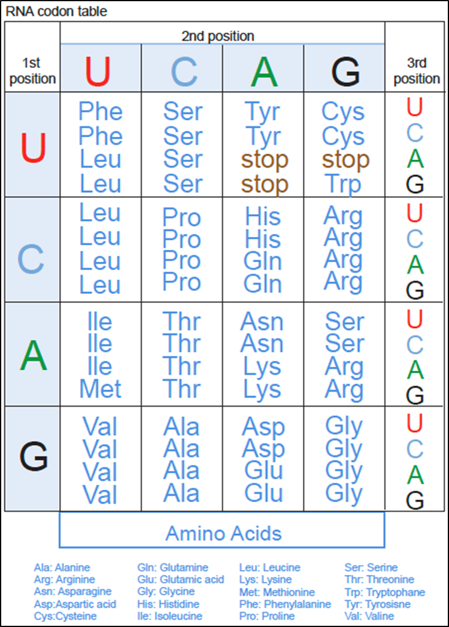
The Universal Genetic Code
The genetic code is universal in all life forms
The genetic code is degenerate.
60 codons for 20 AA
4 special purpose codons
3 are nonsense (stop): UAG, UAA, UGA
AUG is the start codon (occasionally others)

Slide 3
The Reading Frame
6 possible reading frames for codons on DNA / RNA
An open reading frame runs from a start to a nonsense codon
+3
+2
+1
5’-CAACTCCGGCCTTGGTA-3’
3’-GTTGAGGCCGGAACCAT-5’
-1
-2
-3
Frame
CAA CTC CGG CCT TGG TA
1 His Leu Arg Pro Trp –-
C AAC TCC GGC CTT GGT A
2 - Asn Ser Gly Leu Gly –
CA ACT CCG GCC TTG GTA
3 -- Thr Pro Ala Leu Val
Frame
TAC CAA GGC CGG AGT TG
-1 Tyr Arg Gly Arg Ser –
T ACC AAG GCC GGA GTT G
-2 - Thr Lys Ala Gly Asp –
TA CCA AGG CCG GAG TTG
-3 -- Pro Arg Pro Glu Leu

Slide 4

Open Reading Frames (ORFs) http://www.ncbi.nlm.nih.gov/gorf/gorf.html
The triplet code in a DNA duplex has 6 reading frames 3 forward and 3 reverse in the complimentary strand
In most organisms the ORF starts with atg (Met) ends with a stop codon (taa, tag or tga).

Slide 5
Finding Genes in Genomic DNA
Translate (in all 6 reading frames) and look for similarity to known protein sequences
Look for long Open Reading Frames (ORFs) between start and stop codons (start=ATG, stop=TAA, TAG, TGA)
Look for known gene markers
TAATAA box, intron splice sites, etc.
Statistical methods (codon preference)

Slide 6
Step-by-step
Take the following DNA sequence,
5’-ATGGAAGTATAA-3’
Break into triplets,
5’-ATGGAAGTATAA-3’
Go to your table decode the information
M-E-V-STOP
Thus, computer programs can translate DNA into proteins into any of the six possible reading frames.

Slide 7
Sequence Variation and its Consequences

Slide 8
Types of SNPs
• Non protein coding SNPs • Coding SNPs – Synonymous SNPs (third position variation) – Replacement SNPs (change Amino acid) • Functional SNPs (acceptable amino acid replacement) • Non-functional SNPs (traits & diseases)

Slide 9
Single Nucleotide...Difference
…AGGTTAG…
frequency > 1%
SNP: single nucleotide polymorphism
SNV: single nucleotide variation
mutation
SNC: single nucleotide change

Slide 10
Common Variation Terminology
Non-synonymous: changes the amino acid
missense
nonsense
stop codon
frameshift
indel not evenly divisible by 3
Synonymous: no change to amino acid
silent
also applied to non-coding regions

Slide 11
Insertions & Deletions
Indels
Reference
…AAGGATGC…
Insertion
…AAGGCATGC…
Deletion
…AAG--TGC…
Deletion
…AAGTGC…
…AAG--TGC…

Slide 12
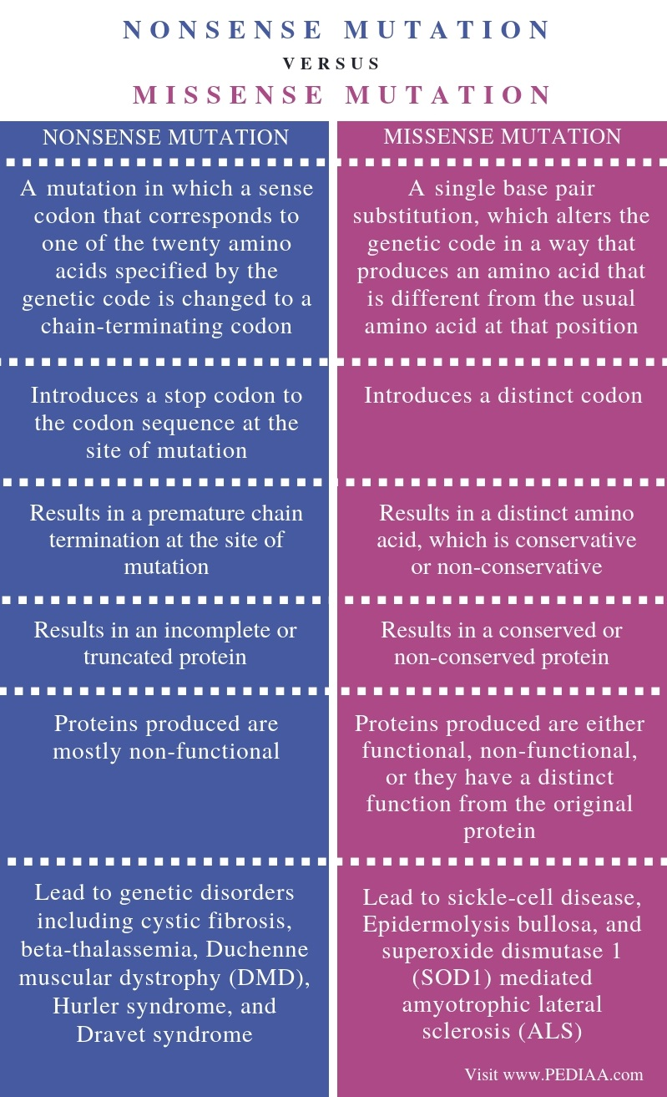
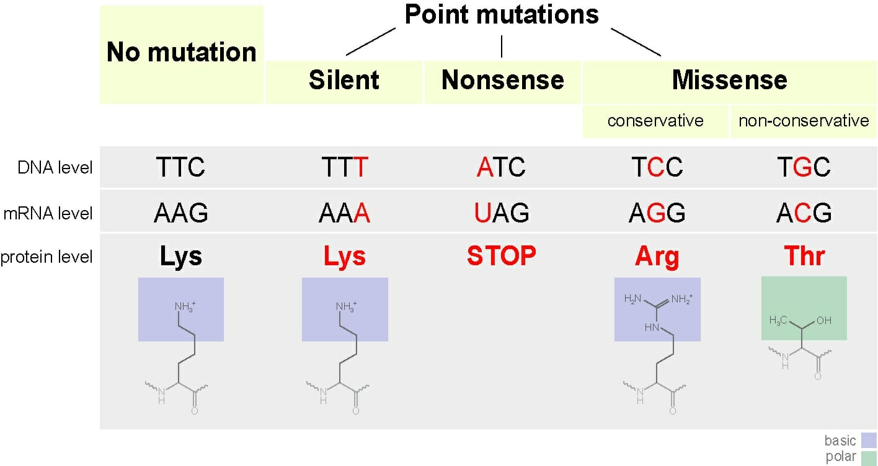
Example

Slide 13
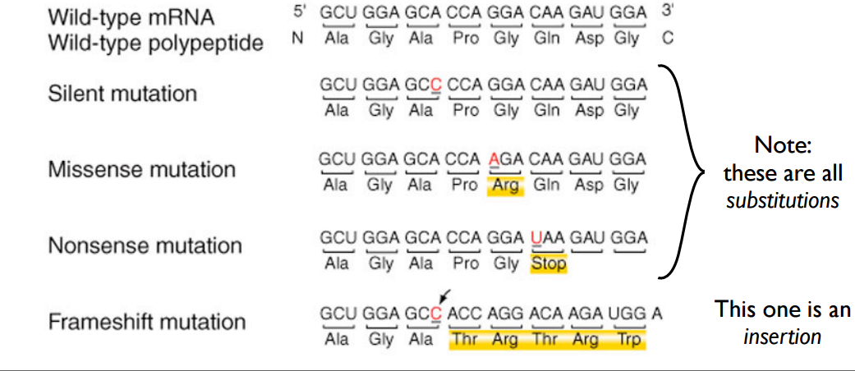
Examples

Slide 14
MUTATIONS
Mutations are alterations in the DNA that produce a sequence that is different from normal DNA/Protein.
Types:
Neutral/Silent Mutations: Change in DNA but not in protein
Missense: Change in DNA and protein
Nonsense: Change in DNA, protein production stops

Slide 15
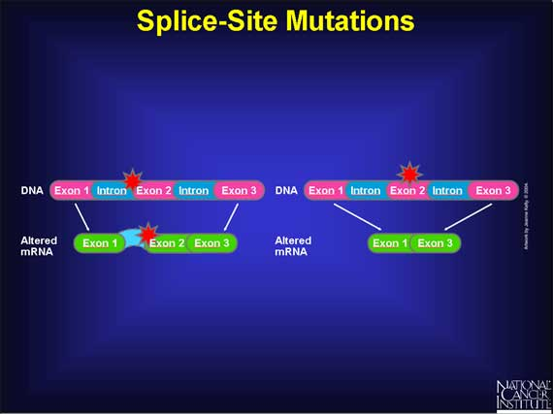
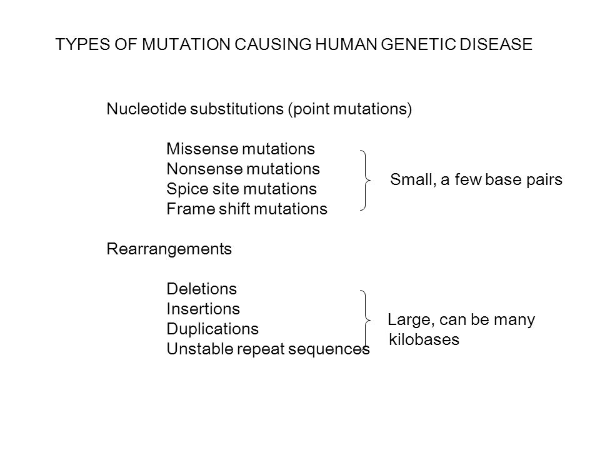
Summary

Slide 16
Correlation between sequence variation and human disease

Slide 17
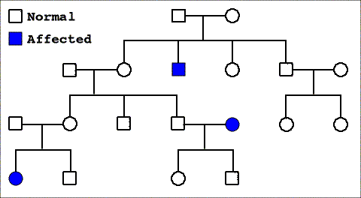
Why are Variations Important?
Most diseases have a genetic contribution
Know this from family pedigrees
Mendelian/Monogenic diseases
Notes:
image source: http://ngbiologyblog.wordpress.com/

Slide 18
Monogenic Diseases
Mendelian, monogenic, rare
CFTR
Cystic fibrosis
Environmental
&
epigenetic factors
HBB
Sickle cell disease
HFE
Hemochromatosis

Slide 19
Cystic Fibrosis Transmembrane Regulator Gene
deletion
Normal CFTR gene
…ATC ATC TTT GGT GTT…
I I F G V
506 507 508 509 510
…ATC ATT GGT GTT…
CFTR DF508
I I G V
506 507 508 510

Slide 20
Multigenic Diseases
Complex traits, multigenic, common
FOXP2, PTPN22, HNF1A, OAS1, ITPR3, IL6, ?, ?, ?
Type 1 diabetes
APOE4, APP,
> a dozen more
Environmental
&
epigenetic factors
Alzheimers
LDLR, APOE, APOB-100, APOa, MTHFR, ACE, ITGB3, dozens more
Coronary artery disease

Slide 21

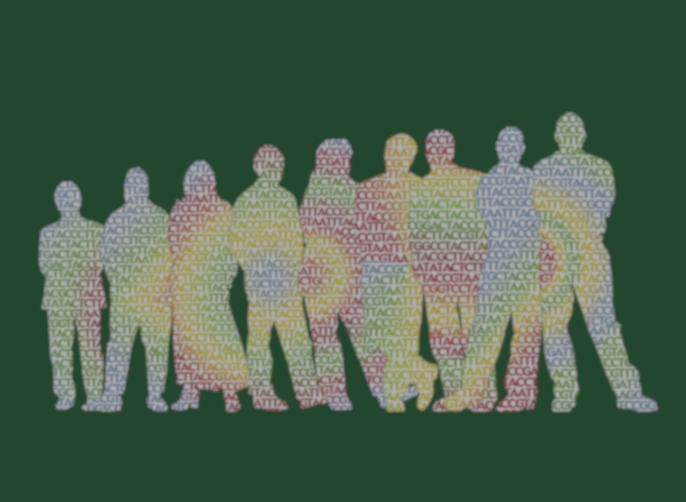


Genome-wide Association Studies
(GWAS)
Patients
Controls
Compare a million SNPs
Which SNPs associate with the disease?
Notes:
image source: NHGRI

Slide 22
Positive Selection Mutations
Mutations can cause disease, especially if they occur within genes.
If a mutation gives benefit to the organism, the organism may thrive and reproduce and help the organism compete with others for resources. This is called positive selection.

Slide 23
Negative Selection Mutations
On the other hand, if the mutation causes the organism to be sickly, the mutation will not survive in the offspring. This is called negative selection.

Slide 24
Neutral Mutations
Most mutations neither help nor harm the organism primarily because they rarely occur in genes (remember only 2% of the human genome codes for genes).
Furthermore, even if mutations do occur in the genes, many do not alter the amino acid sequence of proteins due to the degeneracy of the genetic code.
Mutations that do not alter the fitness of the organism are called neutral mutations.

Slide 25
Deletion Mutations
The most devastating mutations are those in which one or more nucleotides are deleted (called a deletion mutation) within a gene. These often cause a change in the amino acid sequence.
Example: if the sequence ATGTCTTCCTACAGAGGTTAA had a deletion of the thirteenth nucleotide, A, the codons resulting from this deletion, ATG TCT TCC TAC GAG GTT AA, would produce the amino acid sequence MSSYEV.

Slide 26
This sequence differs from the original sequence, MSSYRG and it does not have a proper stop codon.
When the deletion causes a change in the amino acid sequence after the deletion point, it is called a frameshift because the protein translation machinery adds amino acids to the growing polypeptide chain that were not originally intended for the protein.
If the protein is essential for life, the deletion mutation can be life threatening. Equally devastating is an insertion mutation. Here, one or more nucleotides are inserted into the gene causing a gross alteration in the protein sequence.

